Slide 1

Vn
TEAM
Let Slides Talk!

Slide 2




SMART LIGHT

Slide 3
SMART LIGHT
AUTOMATIC
CHEAP
Save energy

Slide 4

WHAT WE NEED
?

Slide 5
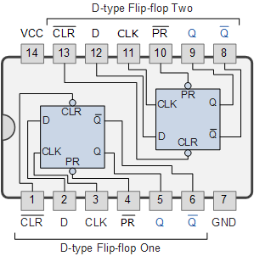
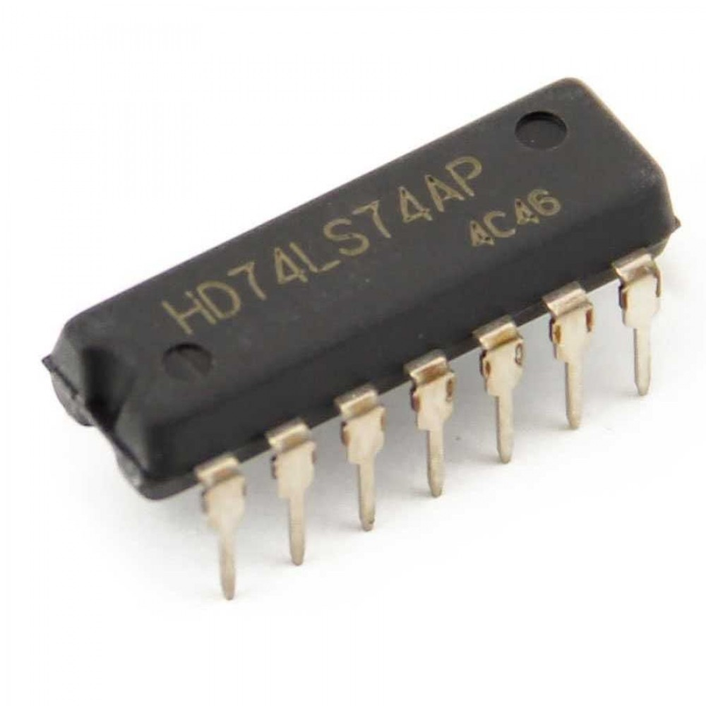
WHAT WE NEED
1

Slide 6
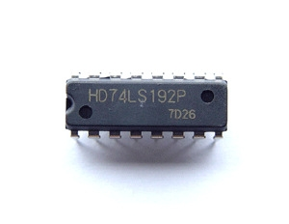
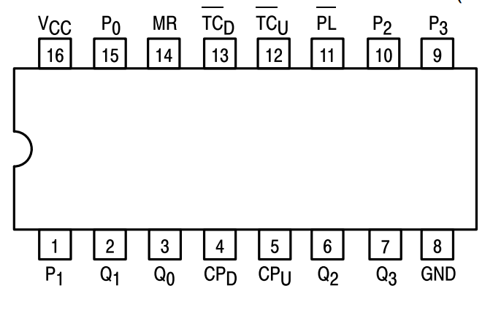
WHAT WE NEED
2
PRESETTABLE 4-BIT BINARY UP/DOWN COUNTER

Slide 7
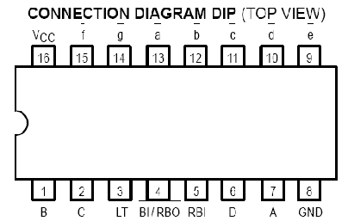
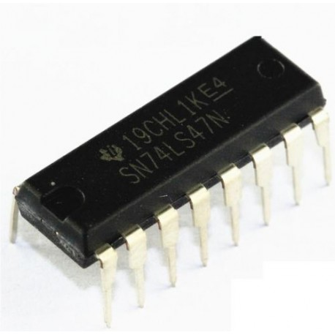
WHAT WE NEED
3

Slide 8
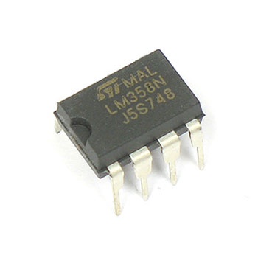
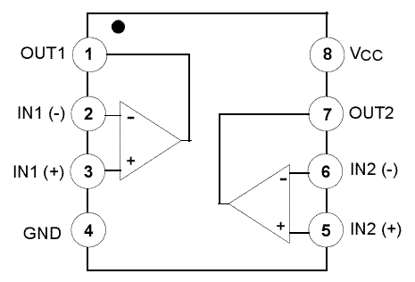
WHAT WE NEED
4

Slide 9
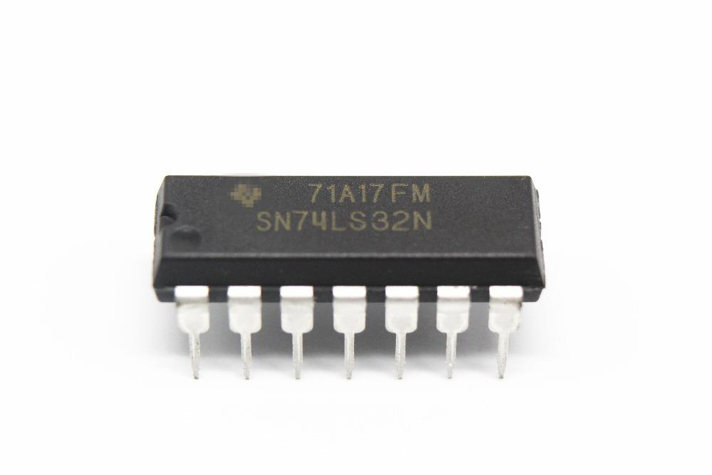
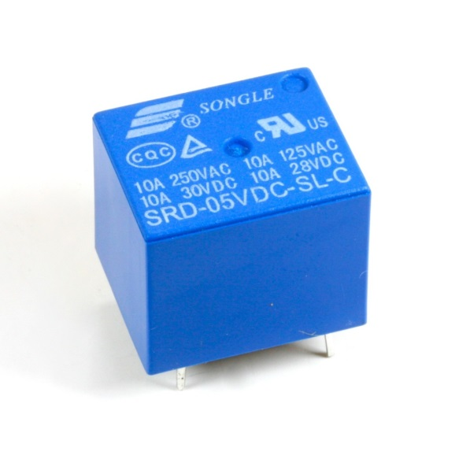
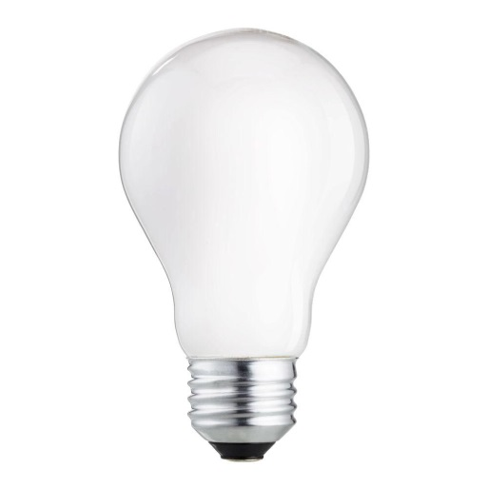
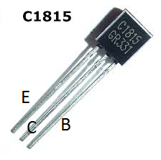
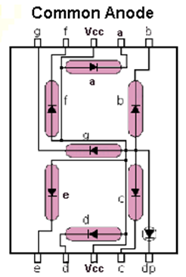
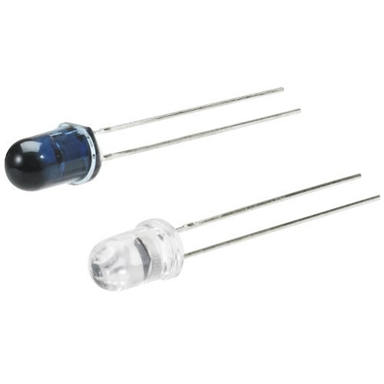
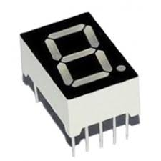
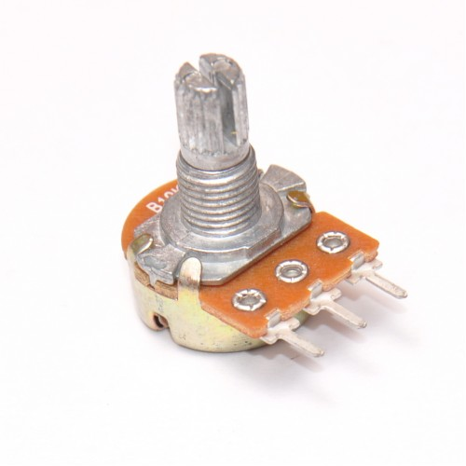
WHAT WE NEED
...
~ 220V
1K

Slide 10

HOW DOES IT WORK
Block diagram
?
1
74ls74
74ls192
2
74ls47
Lm358
3

Slide 11
HOW DOES IT WORK
1
IR
LM358
FlipflopD
Counter
~ 220V
OR
7447-7SEG

Slide 12
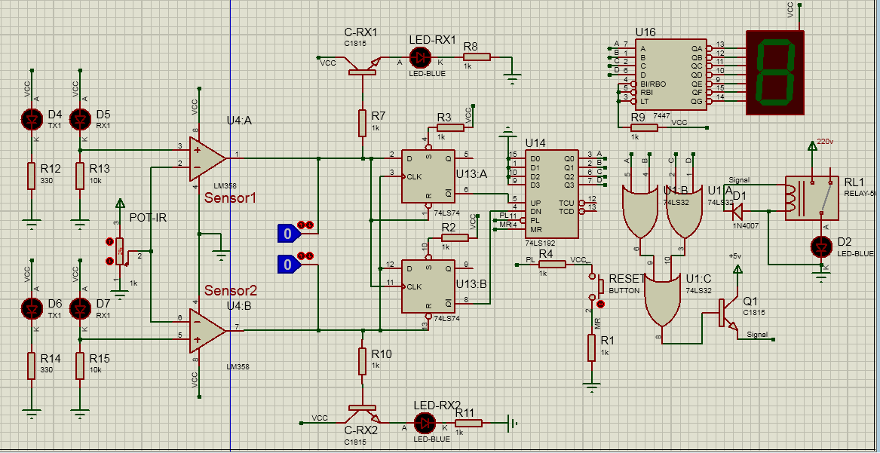
HOW DOES IT WORK
1

Slide 13
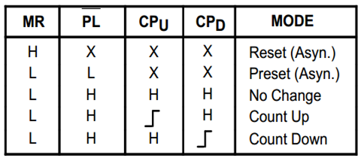
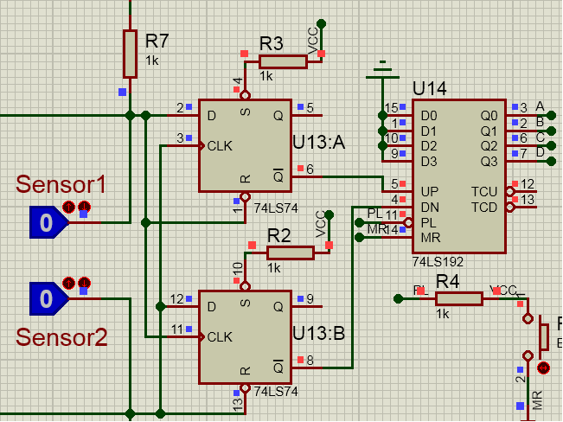
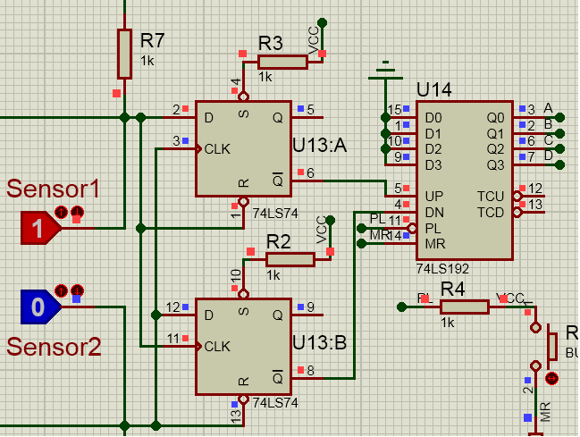
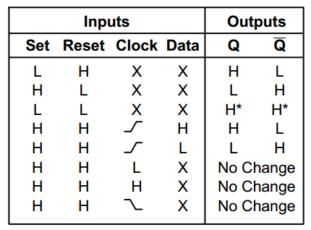
HOW DOES IT WORK
2
74ls192
74ls74
: Sensor1
: Sensor2
: Both

Slide 14
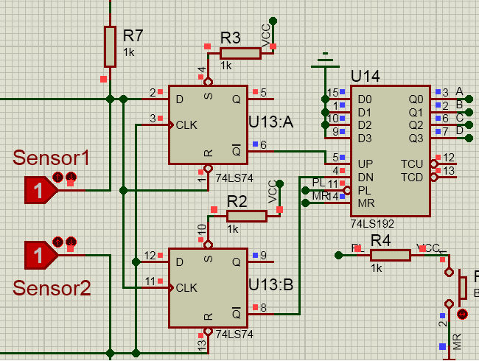
HOW DOES IT WORK
2
74ls192
74ls74
: Sensor1
: Sensor2
: Both

Slide 15
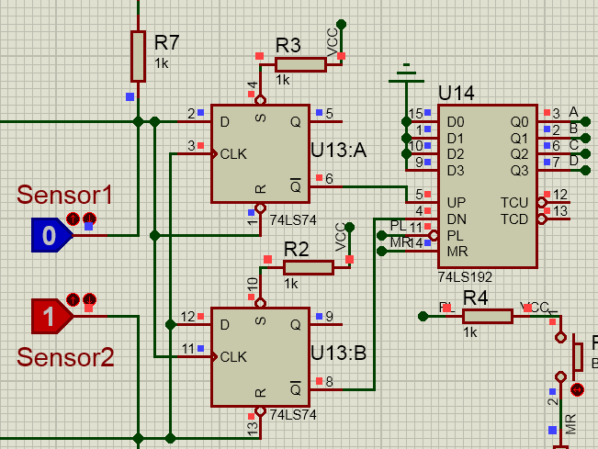
HOW DOES IT WORK
2
74ls192
74ls74
: Sensor1
: Sensor2
: Both

Slide 16
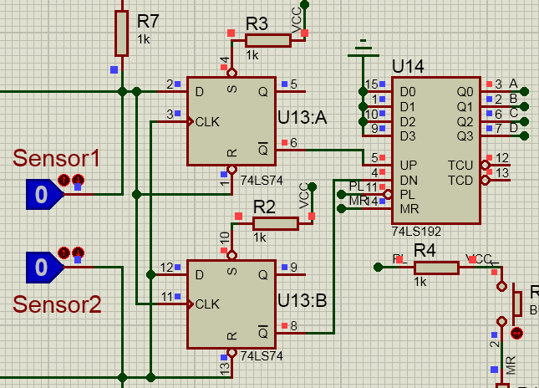
HOW DOES IT WORK
2
74ls192
74ls74
: Sensor1
: Sensor2
: Both

Slide 17
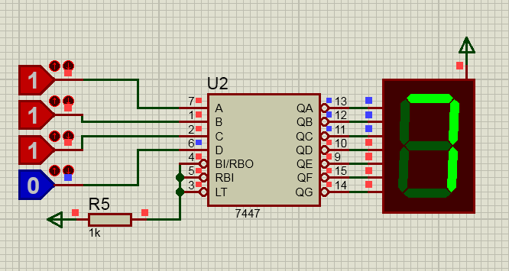
HOW DOES IT WORK
3

Slide 18
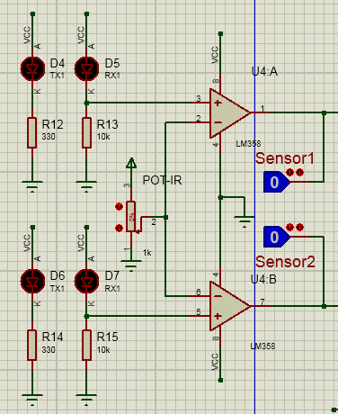
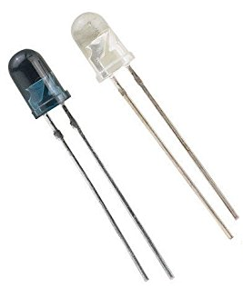
HOW DOES IT WORK
3

Slide 19

Run!
CHECK
Run!
OUR
demo
Start

Slide 20

Thank you for LISTENING!

